Slide 1


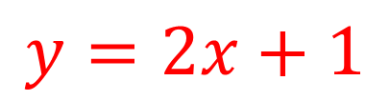
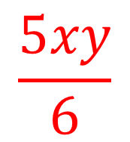
My Algebra
Interactive Notebook
$$\frac{5xy}{6}$$
$$3ab$$
$$2x+3y$$
$$y=2x+1$$
Name
Class
Term 3 Semester 2

Slide 2
Contents
Page
Date
Description
2
3

Slide 3
Tasks
24
7
30
Essential Question
Questions
Notes
Summary
10
11

Slide 4
24
7
30
Date
Solving Equations –Two Steps
EQ – How are inverse operations used to solve equations with two steps?
11

Slide 5
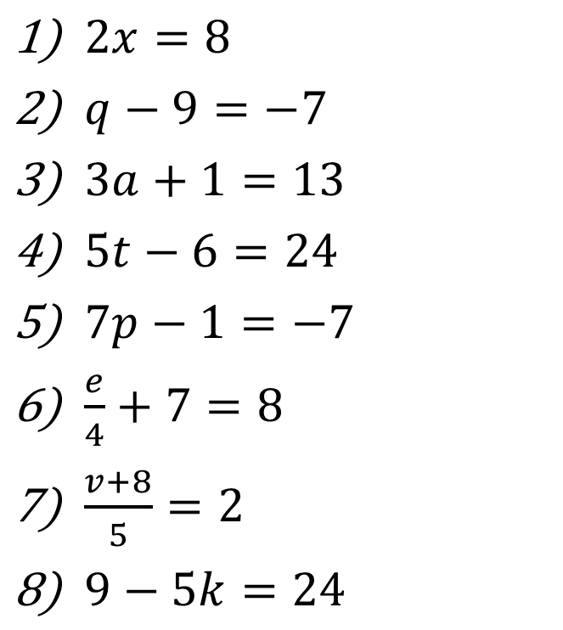
Task – Read and write
$2x=8$
$q−9=−7$
$3a+1=13$
$5t−6=24$
$7p−1=−7$
$\frac{e}{4}+7=8$
$\frac{v+8}{5}=2$
$9−5k=24$

Slide 6
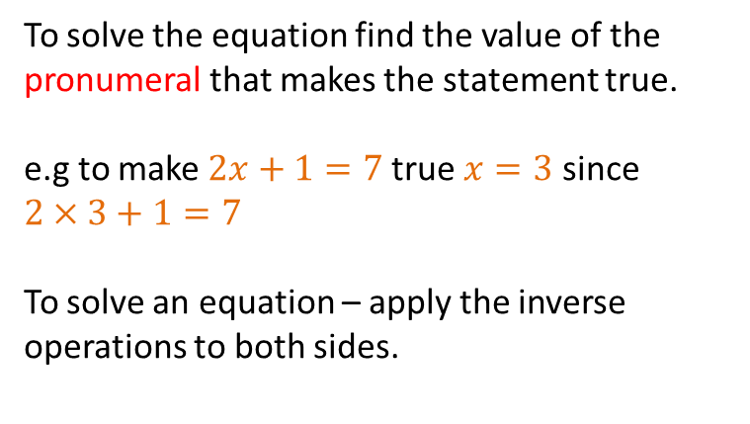
24
7
30
Date
Solving Equations –Two Steps
EQ – How are inverse operations used to solve equations with two steps?
To solve the equation find the value of the pronumeral that makes the statement true.
e.g to make $2x+1=7$true $x=3$ since $2×3+1=7$
To solve an equation – apply the inverse operations to both sides.
11

Slide 7

24
7
30
Date
Solving Equations –Two Steps
EQ – How are inverse operations used to solve equations with two steps?
To solve the equation find the value of the pronumeral that makes the statement true.
e.g to make $2x+1=7$true $x=3$ since $2×3+1=7$
To solve an equation – apply the inverse operations to both sides.
e.g Solve $2x+1=7$
11

Slide 8

24
7
30
Date
Solving Equations –Two Steps
EQ – How are inverse operations used to solve equations with two steps?
To solve the equation find the value of the pronumeral that makes the statement true.
e.g to make $2x+1=7$true $x=3$ since $2×3+1=7$
To solve an equation – apply the inverse operations to both sides.
e.g Solve $2x+1=7$
$$x$$
11

Slide 9


24
7
30
Date
Solving Equations –Two Steps
EQ – How are inverse operations used to solve equations with two steps?
To solve the equation find the value of the pronumeral that makes the statement true.
e.g to make $2x+1=7$true $x=3$ since $2×3+1=7$
To solve an equation – apply the inverse operations to both sides.
e.g Solve $2x+1=7$
$$x$$
$$×2$$
$$+1$$
7
11

Slide 10
24
7
30
Date
Solving Equations –Two Steps
EQ – How are inverse operations used to solve equations with two steps?
To solve the equation find the value of the pronumeral that makes the statement true.
e.g to make $2x+1=7$true $x=3$ since $2×3+1=7$
To solve an equation – apply the inverse operations to both sides.
e.g Solve $2x+1=7$
$$x$$
$$×2$$
$$+1$$
7
11

Slide 11


24
7
30
Date
Solving Equations –Two Steps
EQ – How are inverse operations used to solve equations with two steps?
To solve the equation find the value of the pronumeral that makes the statement true.
e.g to make $2x+1=7$true $x=3$ since $2×3+1=7$
To solve an equation – apply the inverse operations to both sides.
e.g Solve $2x+1=7$
$$x$$
$$×2$$
$$+1$$
7
$$÷2$$
$$−1$$
11

Slide 12

24
7
30
Date
Solving Equations –Two Steps
EQ – How are inverse operations used to solve equations with two steps?
To solve the equation find the value of the pronumeral that makes the statement true.
e.g to make $2x+1=7$true $x=3$ since $2×3+1=7$
To solve an equation – apply the inverse operations to both sides.
e.g Solve $2x+1=7$
$$x$$
$$×2$$
$$+1$$
7
$$3$$
$$÷2$$
$$−1$$
11

Slide 13

24
7
30
Date
Solving Equations –Two Steps
EQ – How are inverse operations used to solve equations with two steps?
To solve the equation find the value of the pronumeral that makes the statement true.
e.g to make $2x+1=7$true $x=3$ since $2×3+1=7$
To solve an equation – apply the inverse operations to both sides.
e.g Solve $2x+1=7$
$$x$$
$$×2$$
$$+1$$
7
$$3$$
$$÷2$$
$$−1$$
$$∴x=3$$
11

Slide 14
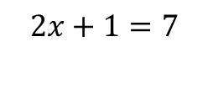
24
7
30
Date
Solving Equations –Two Steps
EQ – How are inverse operations used to solve equations with two steps?
To solve the equation find the value of the pronumeral that makes the statement true.
e.g to make $2x+1=7$true $x=3$ since $2×3+1=7$
To solve an equation – apply the inverse operations to both sides.
e.g Solve $2x+1=7$
$$x$$
$$×2$$
$$+1$$
7
$$2x+1=7$$
$$3$$
$$÷2$$
$$−1$$
$$∴x=3$$
11

Slide 15
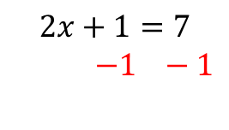
24
7
30
Date
Solving Equations –Two Steps
EQ – How are inverse operations used to solve equations with two steps?
To solve the equation find the value of the pronumeral that makes the statement true.
e.g to make $2x+1=7$true $x=3$ since $2×3+1=7$
To solve an equation – apply the inverse operations to both sides.
e.g Solve $2x+1=7$
$$x$$
$$×2$$
$$+1$$
7
$$2x+1=7$$
$−1 −1$
$$3$$
$$÷2$$
$$−1$$
$$∴x=3$$
11

Slide 16
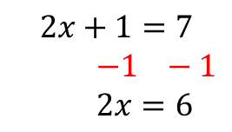
24
7
30
Date
Solving Equations –Two Steps
EQ – How are inverse operations used to solve equations with two steps?
To solve the equation find the value of the pronumeral that makes the statement true.
e.g to make $2x+1=7$true $x=3$ since $2×3+1=7$
To solve an equation – apply the inverse operations to both sides.
e.g Solve $2x+1=7$
$$x$$
$$×2$$
$$+1$$
7
$$2x+1=7$$
$−1 −1$
$2x=6$
$$3$$
$$÷2$$
$$−1$$
$$∴x=3$$
11

Slide 17
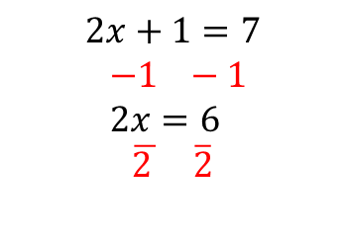
24
7
30
Date
Solving Equations –Two Steps
EQ – How are inverse operations used to solve equations with two steps?
To solve the equation find the value of the pronumeral that makes the statement true.
e.g to make $2x+1=7$true $x=3$ since $2×3+1=7$
To solve an equation – apply the inverse operations to both sides.
e.g Solve $2x+1=7$
$$x$$
$$×2$$
$$+1$$
7
$$2x+1=7$$
$−1 −1$
$2x=6$
$\overline{2 } \overline{2}$
$$3$$
$$÷2$$
$$−1$$
$$∴x=3$$
11

Slide 18
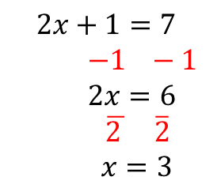
24
7
30
Date
Solving Equations –Two Steps
EQ – How are inverse operations used to solve equations with two steps?
To solve the equation find the value of the pronumeral that makes the statement true.
e.g to make $2x+1=7$true $x=3$ since $2×3+1=7$
To solve an equation – apply the inverse operations to both sides.
e.g Solve $2x+1=7$
$$x$$
$$×2$$
$$+1$$
7
$$2x+1=7$$
$−1 −1$
$2x=6$
$\overline{2 } \overline{2}$
$x=3$
$$3$$
$$÷2$$
$$−1$$
$$∴x=3$$
11

Slide 19





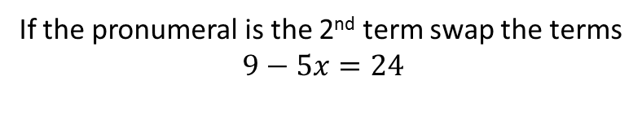

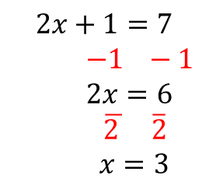


24
7
30
Date
Solving Equations –Two Steps
EQ – How are inverse operations used to solve equations with two steps?
To solve an equation – apply the inverse operations to both sides.
e.g Solve $2x+1=7$
$$x$$
$$×2$$
$$+1$$
7
$$2x+1=7$$
$−1 −1$
$2x=6$
$\overline{2 } \overline{2}$
$x=3$
$$3$$
$$÷2$$
$$−1$$
$$∴x=3$$
11
If the pronumeral is the 2nd term swap the terms
$$9−5x=24$$

Slide 20
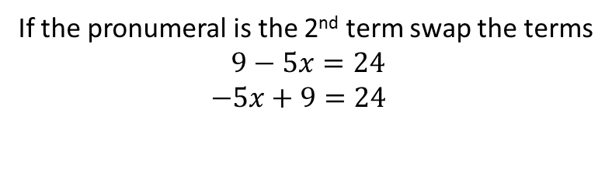
24
7
30
Date
Solving Equations –Two Steps
EQ – How are inverse operations used to solve equations with two steps?
To solve an equation – apply the inverse operations to both sides.
e.g Solve $2x+1=7$
$$x$$
$$×2$$
$$+1$$
7
$$2x+1=7$$
$−1 −1$
$2x=6$
$\overline{2 } \overline{2}$
$x=3$
$$3$$
$$÷2$$
$$−1$$
$$∴x=3$$
11
If the pronumeral is the 2nd term swap the terms
$$9−5x=24$$
$$−5x+9=24$$

Slide 21
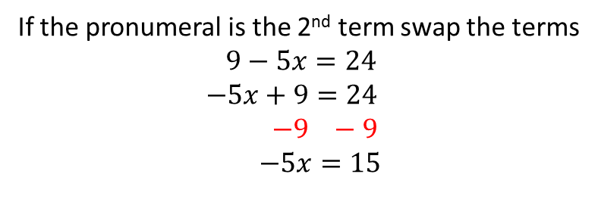

24
7
30
Date
Solving Equations –Two Steps
EQ – How are inverse operations used to solve equations with two steps?
To solve an equation – apply the inverse operations to both sides.
e.g Solve $2x+1=7$
$$x$$
$$×2$$
$$+1$$
7
$$2x+1=7$$
$−1 −1$
$2x=6$
$\overline{2 } \overline{2}$
$x=3$
$$3$$
$$÷2$$
$$−1$$
$$∴x=3$$
If the pronumeral is the 2nd term swap the terms
$$9−5x=24$$
$$−5x+9=24$$
$−9 −9$
$$−5x=15$$
11

Slide 22
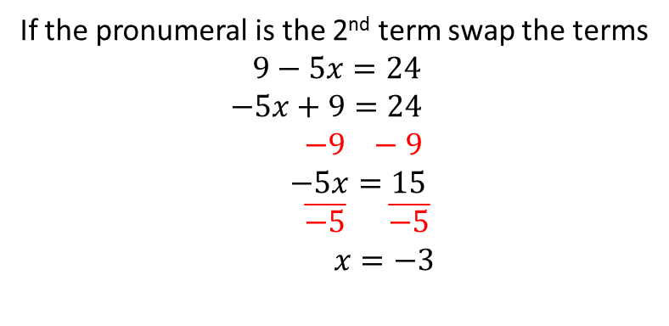
24
7
30
Date
Solving Equations –Two Steps
EQ – How are inverse operations used to solve equations with two steps?
To solve an equation – apply the inverse operations to both sides.
e.g Solve $2x+1=7$
$$x$$
$$×2$$
$$+1$$
7
$$2x+1=7$$
$−1 −1$
$2x=6$
$\overline{2 } \overline{2}$
$x=3$
$$3$$
$$÷2$$
$$−1$$
$$∴x=3$$
If the pronumeral is the 2nd term swap the terms
$$9−5x=24$$
$$−5x+9=24$$
$−9 −9$
$$−5x=15$$
$\overline{−5} \overline{−5}$
$x=−3$
11

Slide 23
Fill in the questions

Slide 24
24
7
30
Date
Solving Equations –Two Steps
EQ – How are inverse operations used to solve equations with two steps?
To solve an equation – apply the inverse operations to both sides.
e.g Solve $2x+1=7$
$$x$$
$$×2$$
$$+1$$
7
$$2x+1=7$$
$−1 −1$
$2x=6$
$\overline{2 } \overline{2}$
$x=3$
$$3$$
$$÷2$$
$$−1$$
$$∴x=3$$
If the pronumeral is the 2nd term swap the terms
$$9−5x=24$$
$$−5x+9=24$$
$−9 −9$
$$−5x=15$$
$\overline{−5} \overline{−5}$
$x=−3$
11

Slide 25
Notes Review
24, 7 ,30
Date
Title
Essential question
Notes complete
Notes complete with colour and diagrams
Questions completed
Contents page filed in
Formula page filled in

Slide 26
Homework
Review your notes and write a summary answering the essential question.

